Slide 1
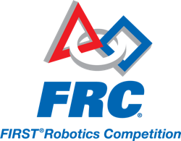
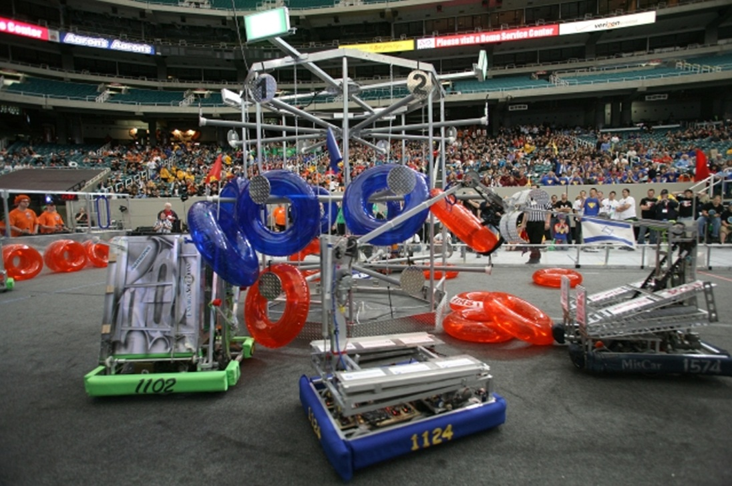
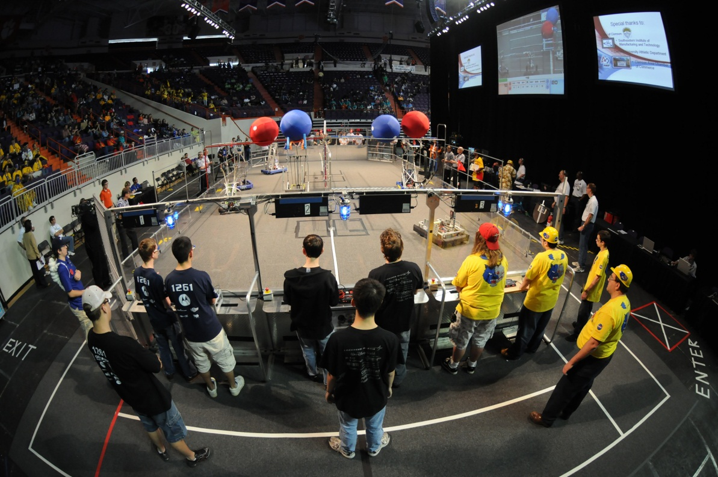
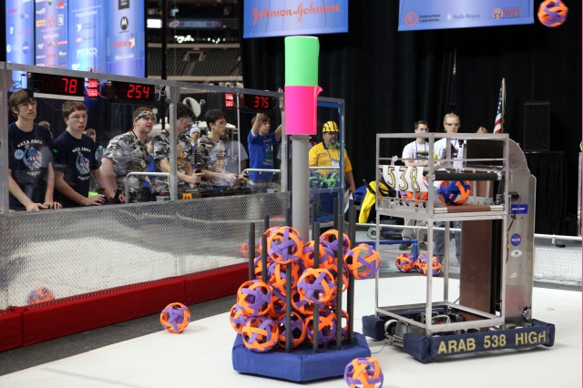

Slide 2
FRC Training #2 Agenda:
Drive Systems, Wheels, Motors
Robot Arms, Belts/Pulleys, Pneumatics
Robotic Control, Sensors, Feedback
Autonomy, Remote Control, Situational Awareness
Case Study: Design Your Robot!

Slide 3
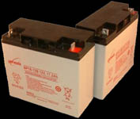
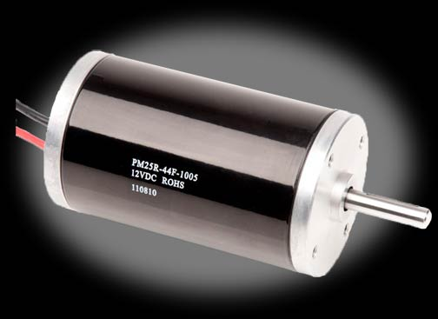
First, a little physics…
Power =
Torque * RPM * (Constant)
Force = m * a
Power = V * I
12V Lead-Acid
17.2 Amp-Hours
21 in-lb Torque
2600 RPM

Slide 4
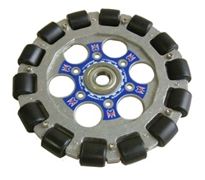
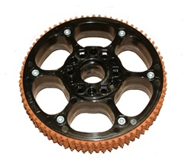
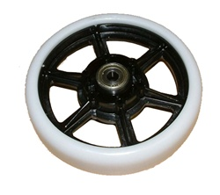
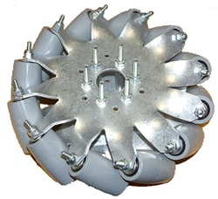
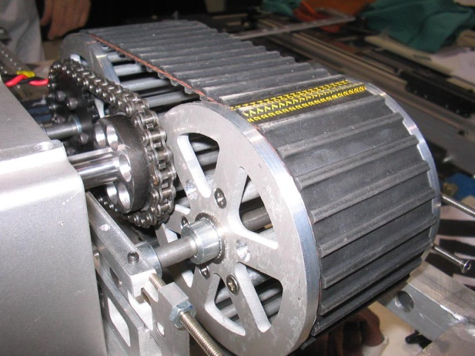
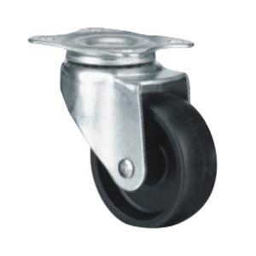
FRC Wheels
Omni Wheel
High-Traction
Slick Wheel
Mecanum
Treads
Casters

Slide 5
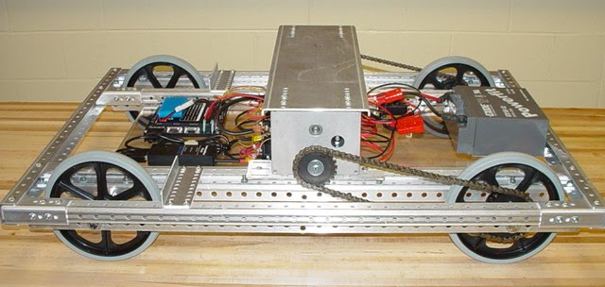
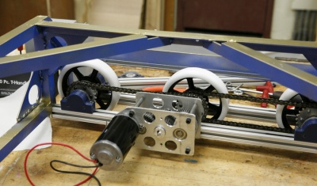
FRC Drivetrains

Slide 6
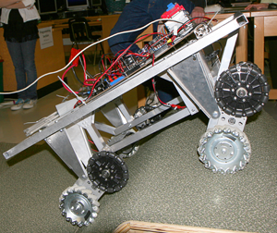
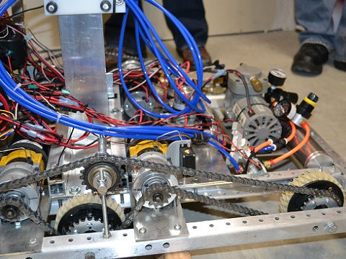
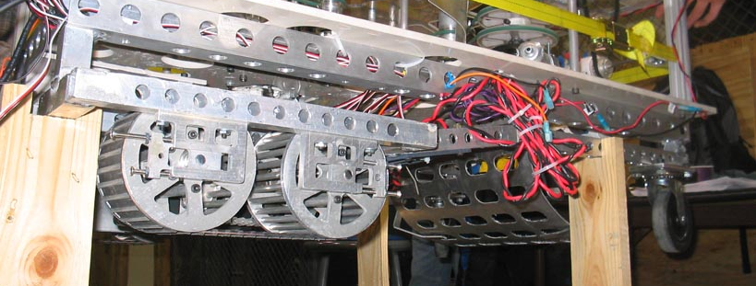
FRC Drivetrains

Slide 7
Drivetrain Things to Consider
Number, Type, and Size of Wheels
Drive (powered) vs Guide (unpowered)
Wide-body or Narrow-body Chassis
One or multiple wheels per motor
Gear and Chain Ratios
Transmission?

Slide 8
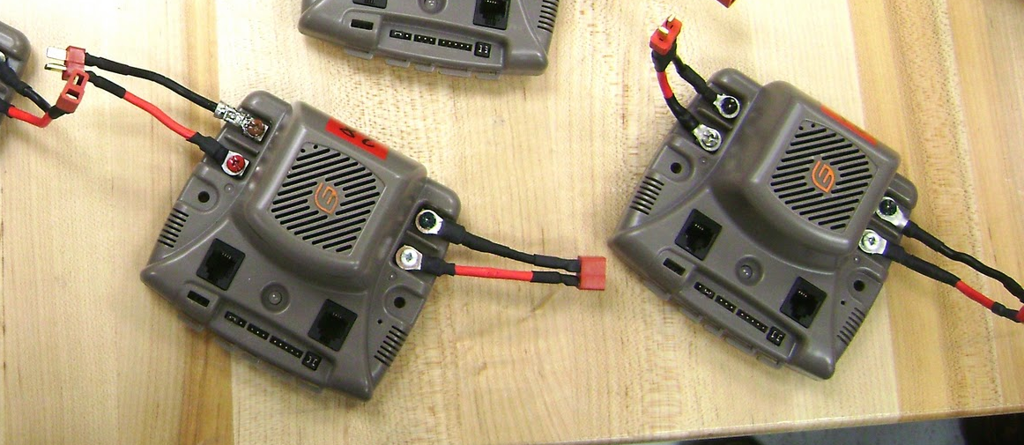
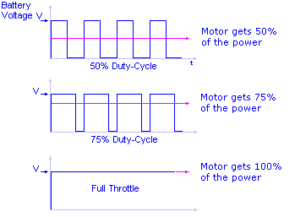
Robot Control: Output
Speed Controllers
Regulate Voltage to Motors
Accepts a “Pulse Width Modulated” (PWM) output from cRio Controller
0% Duty cycle = no power
100% duty cycle = full power

Slide 9
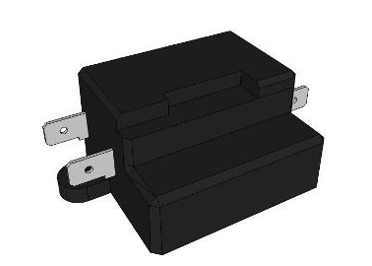
Robot Control: Output
Relays
Full ON (forwards or backwards) or Full OFF

Slide 10
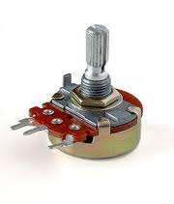
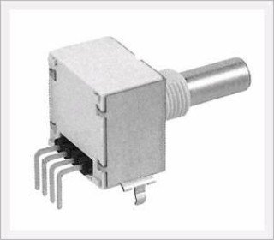
Robot Control: Input
Potentiometer
Optical encoder

Slide 11
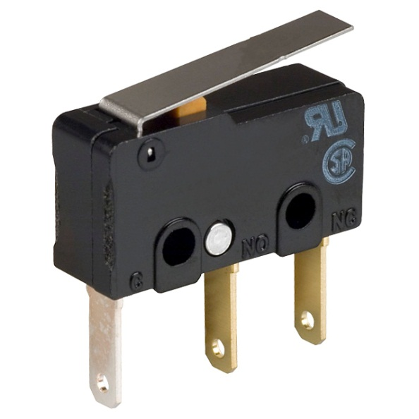
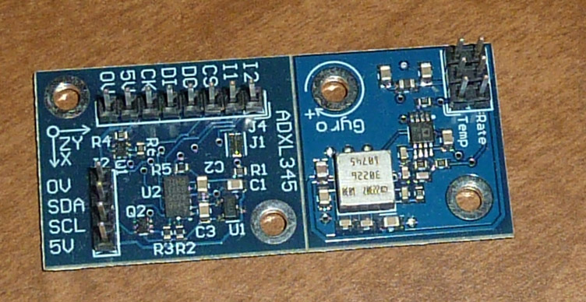
Robot Control: Input
Limit Switch:
Can determine if arm reaches max distance/hard stop
Gyroscope:
Determine direction robot is pointing

Slide 12

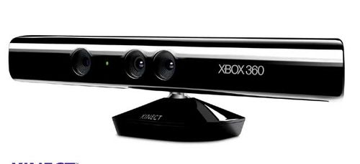
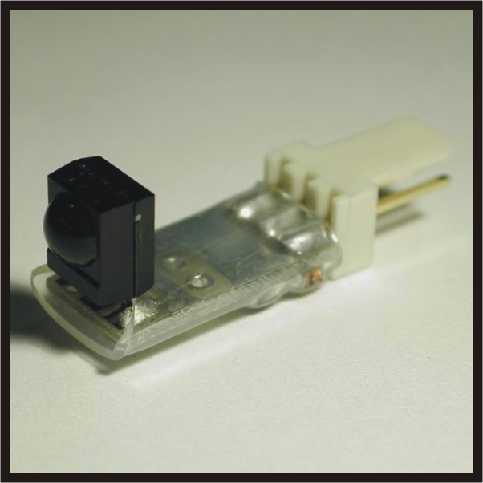
Robot Control: Input
Microsoft Kinect:
3D Imaging and Light Detection
Infrared/Laser Sensor:
Can determine if an object passed in between sensor + transmitter

Slide 13
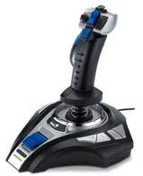
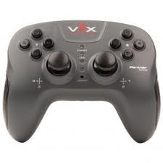
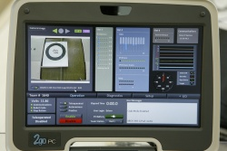
Remote Control
Joystick
Controller
Dashboard

Slide 14
Robot Sequencing

Slide 15

What I Do as a Rocket Scientist – (aka the “day job”)
Spin around!

Slide 16
What I Do as a Rocket Scientist – (aka the “day job”)
How’d I do??

Slide 17
(It’s not quite that simple)
Enable thrusters
Configure spin rate
Switch gainsets
Enable solar array sun tracking
Enable omni antenna
Configure thermal heaters
Update mass properties
Desaturate momentum wheels
Update gyro attitude
??? I’m confused… FAULT!
Lots of commands!

Slide 18
Autonomous Mode
Holy Cows Video
Its all about the sequencing!
Step 1: Arm down + move backward
Step 2: Move forward 6 feet
Step 3: Raise Arm to scoring angle
Step 4: Launch discs
Step 5: Arm down + move backward
Step 6: Turn on disc pickup
Step 7: Drive forward 6 feet
Step 8: Turn off disc pickup
Step 9: Arm up to scoring angle + move backward
Step 10: Launch discs

Slide 19
Robot Autonomy
Situation:
Robot arm needs to pick up game piece on ground, then rotate 50 degrees upward to place on rack
How do we stop arm at 50 degrees?
Potentiometer will tell you position…
… But that’s not enough
Introducing Closed-Loop Control
Proportional – Integral – Derivative “PID” Control

Slide 20
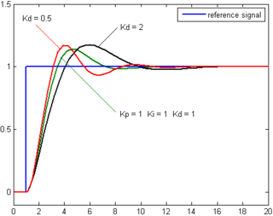
Robot Control
Proportional:
How far away is the desired angle?
Derivative:
How fast am I moving towards the desired angle?
Integral:
How far have I already moved?

Slide 21
Robot Control
Proportional:
Faster when further away
Output = Kp * Δθ
Derivative:
Slows down when getting close (“Dampens”)
Output = Kd * ω
Integral:
Reduces “steady state” error
Output = Ki * θ * Δt
These are known as “GAINS”

Slide 22

Moving from vertical to horizontal
This arm starts out SOOOOOO SLOW!!!
Notes:
Poll Title: What should you do? http://www.polleverywhere.com/multiple_choice_polls/al5GI7B4pnIh0ko

Slide 23
I wanna shoot here
But my arm always ends up here!
Notes:
Poll Title: What should you do? http://www.polleverywhere.com/multiple_choice_polls/ieE7e61rSirtI8n

Slide 24
Robot Autonomy
Situation:
Robot is 30 feet away, need to move sideways to pick up game piece
How do we move straight if you can’t see the robot?
Encoders will tell you how far each wheel moved…
…But that’s not enough
Introducing Motor Drive Boost!

Slide 25
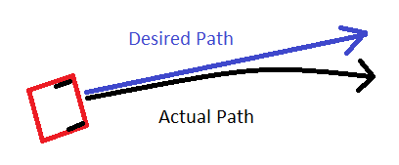
Robot Control
Applying same motor power follows “actual path”
Difference in motor efficiency, gearbox friction, chain tension, misalignment
Must modify motor power based on feedback to move straight

